Slide 1
VDI Lockdown 1.0, securing your deployment to make it “more better”
E2EVC
Patrick Coble, Patrick Coble Consulting
Jarian Gibson, Jarian Gibson Consulting
May 27th 2017

Slide 2
About Jarian
Independent Consultant since 2014
Citrix Technology Professional, VMware EUC Champion, Nutanix Technology Champion, AVI Networks Aviator
Lead up the EUC Practice at Choice Solutions
Platinum partner in Kansas City with presence throughout Central Region and South Florida
Presenting at various conferences/events since 2010
Citrix Synergy, Citrix Summit, BriForum, E2EVC, Citrix User Groups
Co leader of Kanas City Citrix Users Group
Cohost Frontline Chatter podcast

Slide 3
About Patrick
First Off, I’m as cool as Jarian
Nerd & Hacker since the Late 80’s, Joined the Marines did some tours in Iraq and now click and draw on things in the consulting world to try and make things “more better”.
Passion for EUC, Computer Security and Racing (NASA, SCCA, Chump)
Lead the EUC Practice at a Citrix Partner for almost 9 years
Worked at LPS Integration is one of the largest Citrix Platinum Partners in the Southeast, we have EUC clients from 12 CCU to 20k CCU and everything in between.
Leader of Nashville Citrix Users Group
Independent Citrix and Security Nerd
New to the Presentation scheme outside of the Southeast Area, thank you E2EVC for the Opportunity.

Slide 4
Agenda
What's Happening and Past and Current attacks
Citrix Policies
Optimized (Bonus it secures it also)
Winders Policies - AppLocker
Networking and DNS
SSL, TLS, DTLS
NetScaler Application Firewall
AntiVirus
Beyond AppLocker
Conclusion

Slide 5
What's Happened
Since 2008 the Enterprise Attack Surface has changed

Slide 6
What’s Happened
Since VDI’s inception back in 2008 it accelerated the deployment of VDI (Desktop and SBC) and now we have millions of concurrent users using a Citrix solution.
Lots of clients we work with love the ability to lower their numbers of images and how the image management works with PVS and MCS.
But for many clients it makes a bad habit where the OS, hypervisor and many other components are actually updated less often than their traditional PCs.
How can PCs be more up to date than VDIs? In many cases it is because the desktop images were given to the Citrix Nerds and they just chase fires, make it print, do Citrix updates and get ready for the next version and lastly update the image only when they have to. “You Crack It you Buy It”

Slide 7
2014 Was a breaching party (Business)
May 2014, Ebay
233 Million records breached (Usernames, Passwords, Addresses, Phone Numbers) Syrian Electronic Army said they did it.
May 2014, PF Changs
Never released how many records were taken but the cards went up for sale in a hurry.
September 2014, Home Depot
56 Million records breached, 7 Million Businesses
August 2014, JP Morgan Chase
83 Million records breached
November 2014, USPS
800k employees data was stolen.
November 2014, Sony
Inside job blamed on North Korea with some Ransom and Torrent which embarrassed the company.

Slide 8
2015 Was a breaching party (Business)
October 2015, Experian breach hit 15 million T-Mobile customers
15 Million records breached
October 2015, Scottrade
4.6 Million records were taken.
June 2015, OPM + IRS + Prisoners
~21 Million (They got the works from 4 hacks over 3 years)
June 2015, Kaspersky
Major IP Stolen
August 2015, IRS
~200k filers data was stolen.
November 2014, BlueCross BlueShield
~10 Million records breached.
February 2015, Anthem
80 Million records breached.

Slide 9
2016 Was a breaching party (Business)
May 2016, Office of Child Support Enforcement
5 Million records taken from a laptop and hard drive
May 2016, LinkedIn MySpace
Hacker Peace claims to have 176 million user accounts.
March 2016, IRS
750k+ Individuals over a 2 year period
March 2016, Seagate
All past and present employees W2 Information (5-10k)
March 2016, FBI
Personnel Information for 10k DHS and 20K FBI (With leak attempt to motherboard)
May 2016, ADP
exposed the payroll, tax and benefits information of nearly 640,000 companies
January 2016, Centene Corporation
950,000 members had potentially been impacted by a data breach

Slide 10
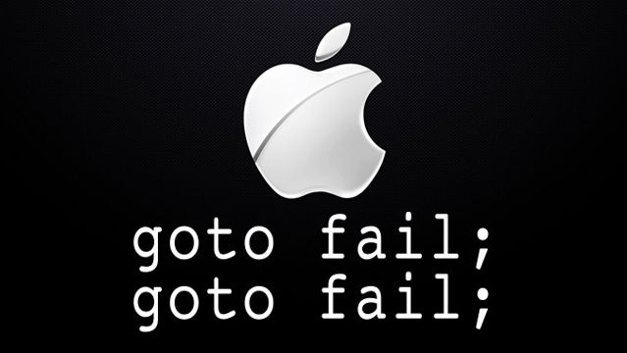
Apple gotoFAIL
February 2014
This started the SSL and TLS party for the whole year leaving the iOS extremely exposed.
No Clue how it got by but wow.

Slide 11

Heartbleed
April 2014
Almost all OpenSSL version were vulnerable and the biggest problem is that OpenSSL Made the news like almost no other bug\vulnerability.
“Some might argue that [Heartbleed] is the worst vulnerability found (at least in terms of its potential impact) since commercial traffic began to flow on the Internet,” Forbes

Slide 12
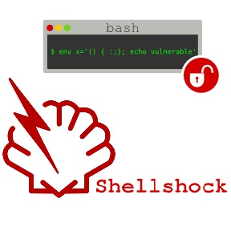

SHELLSHOCK
ShellShock came out in September 2014
This affected systems that were up to this time “more secure” than Winders like OSX and other OS’s in the Linux and BSD family.

Slide 13

BADUSB
BadUSB came out in July 2014
NO DEFENSE
Piggy backing of 20 years of USB basic system access devices can be reprogramed to emulate almost anything and can plant malware and viruses onto a computer on boot up. Physical Access always wins.

Slide 14

Poodle
Poodle “Padding Oracle On Downgraded Legacy Encryption” came out in October 2014
This beat up SSL v3 and would allow a 1 in 256 chance to decode the message with a single session cookie. Really bad news.

Slide 15
Ransom/Cryptolocker
A new trend where a attacker will get in and run some hard drive encryption programs to encrypt all the servers and or workstations and then make you pay on BitCoin. It happens to SMB more than anyone but don’t think you are not susceptible in a big enterprise shop, one spearphishing attack to a admin would give them what they need to place the seed codes and party on.
What to do?
Don’t let them break in
If they get in, you basically don’t have any other option than to pay the ransom and then make sure you find out how they got in and fix things up.
Email is now one of the most dangerous attack surfaces

Slide 16
#WannaCry Ransomeware Variant?
Ransomware Variant from NSA Eternal Blue toolset leak from Wikileaks allowed the normal phishing attack to be deployed or propagated without any user interaction. If you were patched back in March with update MS17-010, you were fine.
If you don’t have a good patching schedule then you didn’t have a fun couple of weeks.
Try and get automated solution for your security updates if possible

Slide 17
Leaky
There have been may Leakers\WhistleBlowers for a long time in all countries history, but now with Technology it is one of the biggest risk to many organizations. If there is sensitive IP in your organization you need to do everything you can to secure it.
Leaks will continue to happen so don’t let your VDI deployment be the conduit for it.
“Your Data is worth more than your product”

Slide 18
Citrix Policies
Default is bad MmmKkayy

Slide 19
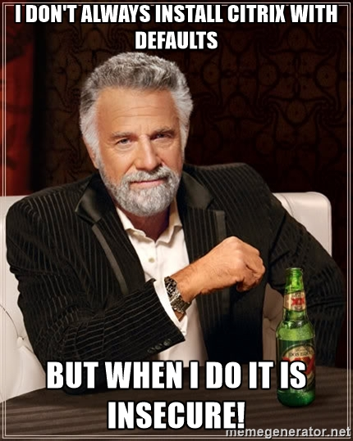
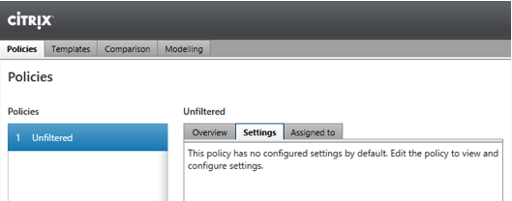
Citrix Policies
Don’t be this person.
Too many clients don’t come up with their security requirements when they deploy Citrix and the defaults are open and shouldn’t be used.

Slide 20
Citrix Policies
Disable all Client mappings unless you need them for specific job roles, exclude people. (Minimum)
You can use unfiltered to lay down the lockdown policy and use policies per user group to turn things back on as needed.
Applying the policies via GPO or the Citrix Studio will both work just make sure you have a way to monitor if either getting edited. The Citrix Studio is logged in the configuration database and GPO’s are audited by the domain controllers if you are collecting events.
Setup Smart Access (Filter External Access at a Minimum (You know your LANs IP)

Slide 21
OS Optimization
Turn off the things you don’t need and it can make it faster

Slide 22
Optimized
Use the Settings that are all over the place for Windows 7, most are fine for Windows 8.x and 10 also. Windows 8 and 10 introduce a ton more services that should could get clipped. (#ProjectVRC)
Remember after all the services are killed make sure and tweak the other things through out the Local Machine Policies (GPO, RegEdit)
Turning off all the services and doing all the tweaks also will secure the image because the only good Winders service is a dead Winder service.
Running a couple PowerShell optimization scripts can help be the first pass to securing them.

Slide 23
Windows Policies
You can doo ittt

Slide 24
Winders Policies - AppLocker
Who has ever used it? (Came out in 2009 with Windows 7)
Users can install and run any non-standard applications
Even standard users can install some types of software (Which is whack)
Unauthorized applications may:
Introduce malware
Increase helpdesk calls
Reduce user productivity by consuming resources that were not accounted for.
Compliance Problems shall incur

Slide 25
Winders Policies - AppLocker
How many of you let your users be admins on their computers?
How many of you have to let your users be admins on their Virtual Desktops or XenApp Servers?
What is one of the best attack methods? SpearPhishing, we just need a click or someone to start to enter their username and password on a cloned site. If you give your users Admin rights and allow them to execute anything you have a big problem.
AppLocker is one of the most powerful security setting system that could be applied.
Even with AntiVirus and Malware protection any executable can run in the user context which can lead to some fun times.

Slide 26
Winders Policies - AppLocker
Three Main AppLocker Goals
Eliminate unwanted/unknown applications in your network
Enforce application standardization within your organization
Easily create and manage flexible rules using Group Policy

Slide 27
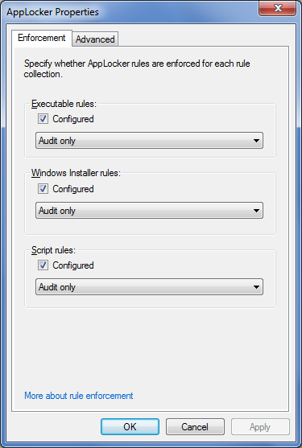
Winders Policies – AppLocker - Audit Only
Audit Only
Step 1: Configure the audit enforcement setting
Step 2: Start the Application Identity service
Step 3: Refresh Group Policy settings on the computer
Step 4: Review the AppLocker log in Event Viewer

Slide 28
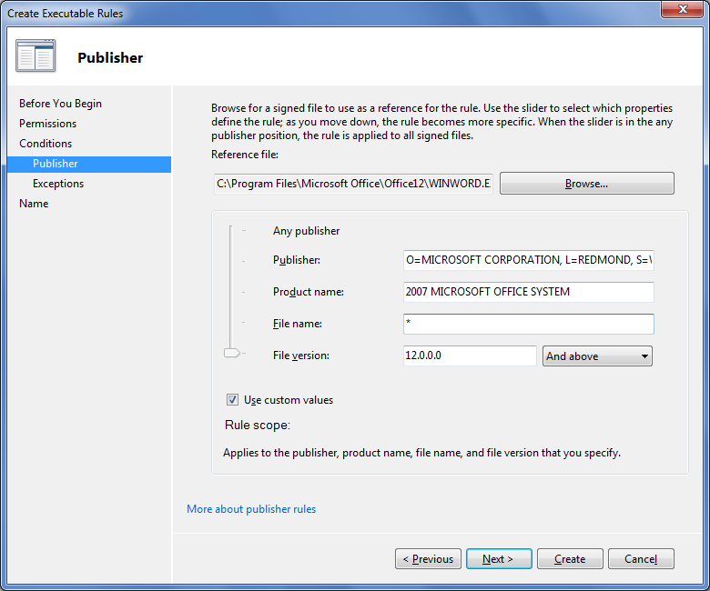
Winders Policies – AppLocker – Block Per User Applications
Main AppLocker Options after Auditing
Allow
Limit execution to “known good” and block everything else
Deny
Deny “known bad” and allow execution of everything else
Exception
Exclude files from allow/deny rule that would normally be included

Slide 29
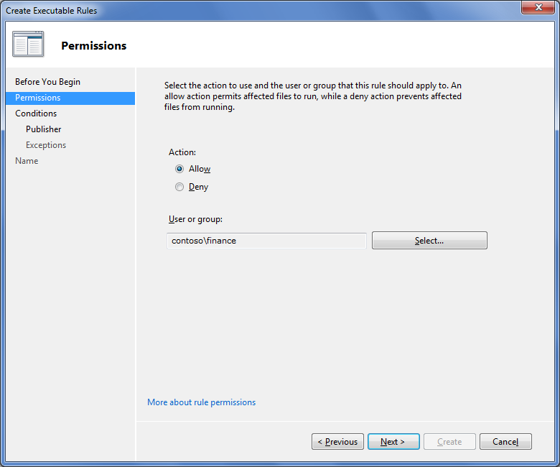
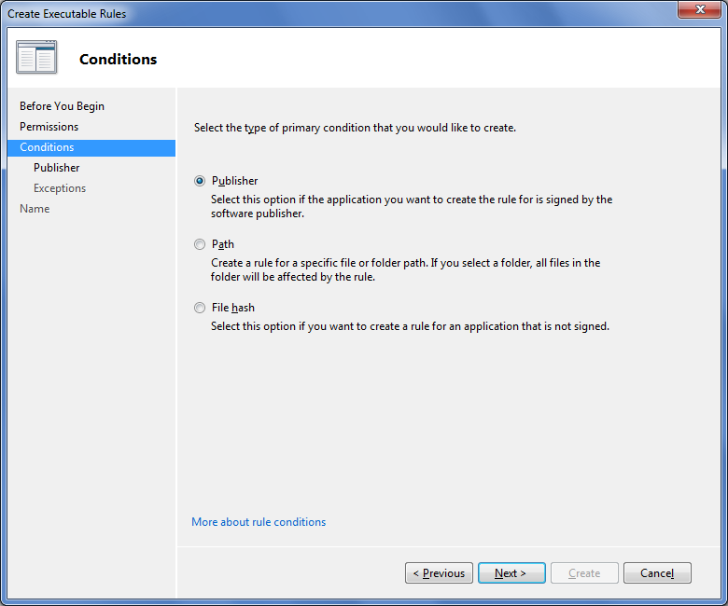
Winders Policies – AppLocker – Doing it (Less than 20 Clicks)

Slide 30
Winders Policies – Windows Firewall
Who turns it off?
Who runs any firewall on their Virtual Desktops or XenApp Servers?
Why not? (Because it is annoying)
As we all know it is very annoying to do these policies and we turn them all off to get things done, but what problem are we creating by doing this?
Most Citrix deployments have a very simple firewall rule set for the Citrix things and then from there Per Application usually isn’t that hard. I hope you have more than one VLAN.

Slide 31
Winders Policies – Windows Firewall + IPSec
Who even runs IPSec anywhere in their deployment?
Why not? (Because it is annoying)
This one isn’t as easy to implement because you need to have a PKI deployment setup and ready to roll to hand out the Certs.
They key is your root certificate private key. Make the deployment and then power off the root server, Yes power it off. Nothing will need that private key other than the other servers for just a short time until they are enrolled. Every 3-5 years “Party on Wayne”.
This can be rolled out to Citrix first or other smaller IT business units in a couple days of testing and then it can take weeks\months to roll it out.
Why shouldn’t things going across the wire be secure, make it actually hard, to get data off your network.
This will make running WireShark when there are problems more complicated but you need to weigh the risks.

Slide 32
Citrix Workspace Environment Management
Bringing Optimization and Policies Together

Slide 33
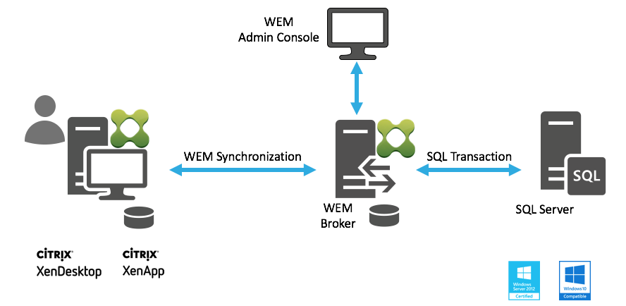
Citrix Workspace Environment Management
System Resources Optimizations
CPU, RAM, IOPS
Profile Management Integration
Contextual Awareness
Process Management
Security – Blacklist & Whitelist

Slide 34
Citrix Workspace Environment Management Demo

Slide 35
Networking and DNS
Got to be able to ping and use the phone book

Slide 36
Networking - VLANs
You best be VLAN’ing things. Make sure you have some basic ACLs between VLANs.
If your using VMware and you have some money then NSX can help make things way more better. Since they now have Network Insight it can be even easier, if you have the money.
The main problem we have in the networking world is we create a VLAN for PVS segregation (Not needed as much now but still good for security) but if you are on Desktop 1 you can talk to Desktop 2 and Desktop 20,000.
East-West Traffic is the new way to mitigate and secure things and NSX is leading that front for now.

Slide 37
NSX Microsegmentation
Phase 1 Just Deploy It, NSX Controllers and Appliances on each server.
Get Arkin\Network Insight Going
Prevent Desktop to Desktop communications
Setup rules to your infrastructure DDC’s, PVS, LIC, AD, DNS, CS, pUAG with a Any\Any Rule
Work on killing the Any/Any rule over a full cycle of users coming in and out “Mileage will vary” then you will need to enforce rules, check hits, enforce rules and check hits until you get less and less hits on the Any/Any Rule.

Slide 38
DNS – Is yours secure?
DNS is the phone book of the windows world and whoever controls DNS controls almost all traffic.
If your using Microsoft DNS there are 10 steps from them on how to secure the server by separating internal and external delegation, only allow secure DNS updates, secure cache for name pollution, update internal root hints, restrict zones delegating zones and a couple more.
DNSSec is the next level of DNS security. There are free or paid options to secure DNS.
OpenDNS - Anyone using it? It can do some awesome things

Slide 39
SSL

Slide 40
SSL – Are you Self-Signed?
If you are rocking default SSL Certificates you are asking for it.
SHA2 keys or nothing, Rekeying will be fun.
Setting up a basic PKI deployment doesn’t take that much time to hand out nice new and shiny SSL certificates. Bigger the Domain Bigger the problems.
NetScaler Management, StoreFront, XML SSL Relay and for IPSec if you are going to next level things.
Disabled SSLV3 everywhere on anything that hosts SSL.
Everything should be using TLS or DTLS (ICA, SMB, RDP, SQL and LDAP)

Slide 41
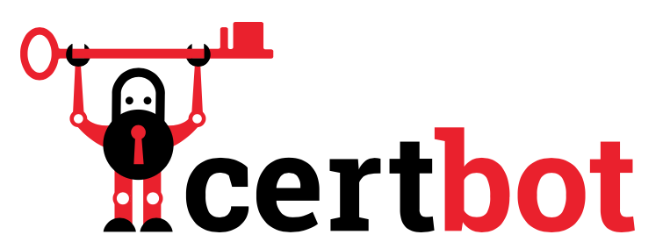
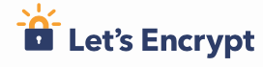
Let’s Encrypt – No reason not to do SSL!
Free and Open CA Service
Free SSL certificates for web services you own
Scriptable & Tools available
ACME clients
Certbot
ACMESharp
Certify
ZeroSSL

Slide 42
Let’s Encrypt Citrix Demo

Slide 43
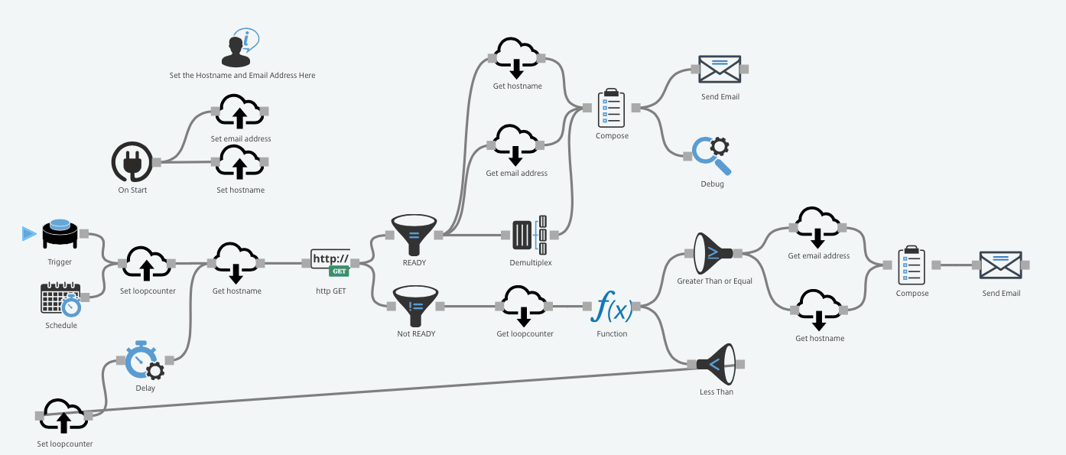
Octoblu NetScaler SSL Labs Checker

Slide 44
Octoblu Demo

Slide 45
NetScaler AppFirewall

Slide 46
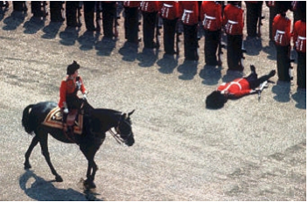
Fixing the Code
You may not be able to fix some code
Application security skills vary across developers
Application change can introduce new security defects
It only takes one …
It only takes one … security defect
Notes:
Susans – change header to Re-engineering
Bullet 2 – “skills vary”
Legacy Applications
How do I get older but Mission-Critical applications to meet Governance and corporate security requirements without rewriting them? The developers aren’t even part of the company anymore!
ISV Applications
How do I fix an application I didn’t write?
How do I mitigate downtime from frequent critical security updates?
How can I patch my applications 2 weeks from the end of the quarter?
Webserver software vulnerabilities
How do I keep my site up while my vendor writes a patch?

Slide 47
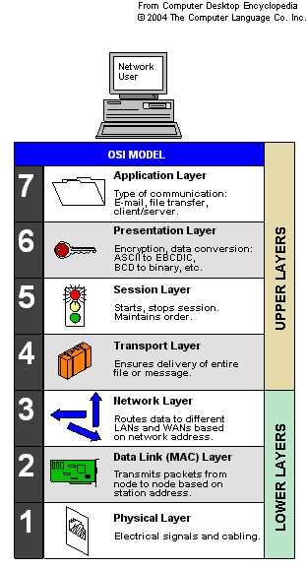

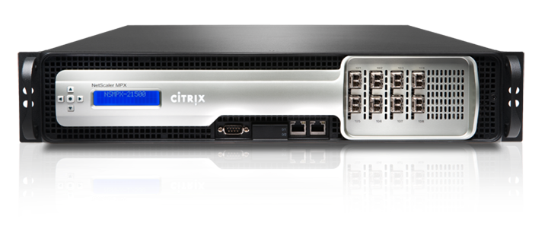
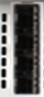
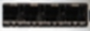
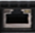

Problem
Solution
86% of the attacks are attacks to the applications
WAF Protection
No Apps protection
Session Layer
Transport Layer
:
:
Network AppFW
Notes:
http://www.h-online.com/security/news/item/Study-confirms-demise-of-the-myth-of-attacks-from-within-915494.html

Slide 48


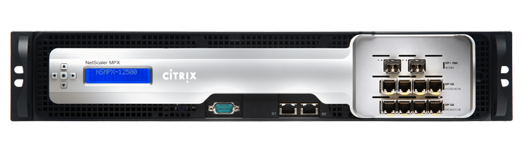
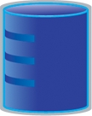
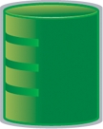
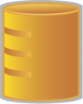
Logical Deployment
Interfaces connected to different networks
Untrusted
Network
Trusted
Network
Internet
Network Firewall
Citrix Application Firewall (in the DMZ)
Network Firewall
Application
Infrastructure
Logical Deployment

Slide 49
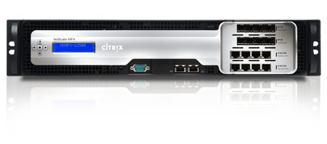
Convergence of Application Security Functions
DDos
SSL
SSL/VPN
WAF
XML FW
AAA
SSO
Reporting
4th Gen Web App Firewall
Fastest App Firewall (40 Gbps)
Best Price-Performance
First to implement learning (Teros)
First to implement positive security
Fine-grained policy driven
NetScaler SDX, MPX and VPX

Slide 50
Hybrid Security Model
Hybrid
Protect Against Known and Unknown Threats
Negative
Apply Signatures
Negative
Hybrid
Positive
Positive
Learn
Application
Environment
Notes:
The Hybrid Security model:
- We have moved AppFw security model to combine best of both the worlds resulting into Hybrid model
- Negative Security Model
- Provides protection against all known threats
- Makes it easy to deploy our solution with signatures for known vulnerabilities
- New signatures can always be downloaded and applied in run time
- Positive Security Model
- Core value proposition driven with the learning ability
- Rock solid deployment model, proven for many years
- Requires time to learn the Application environment
- After you deploy the learnt rules, everything else becomes negative
- With the next release we are combining these 2 models and providing Hybrid approach
- Protects against all known and unknown threats

Slide 51
Hybrid Security Model
Signatures for known attacks
Easy deployment, Quick PoC
Checks request headers (URL, cookies, etc) and body (form fields)
Integrates with scanning tools
Wizard to ease configuration
Mix-and-match with positive security
Defense against zero-day attacks
Defense against custom attacks
Strongest security posture

Slide 52
NetScaler Application Firewall
Setting this up for StoreFront and any other application is definitely a must.
A firewall can only block unwanted network traffic but cannot block attacks to those allowed ports and protocols.
Tell your Security Team that your existing NetScalers can do super cool things.

Slide 53
NetScaler Demo

Slide 54
NetScaler SmartAccess/Smart Control

Slide 55
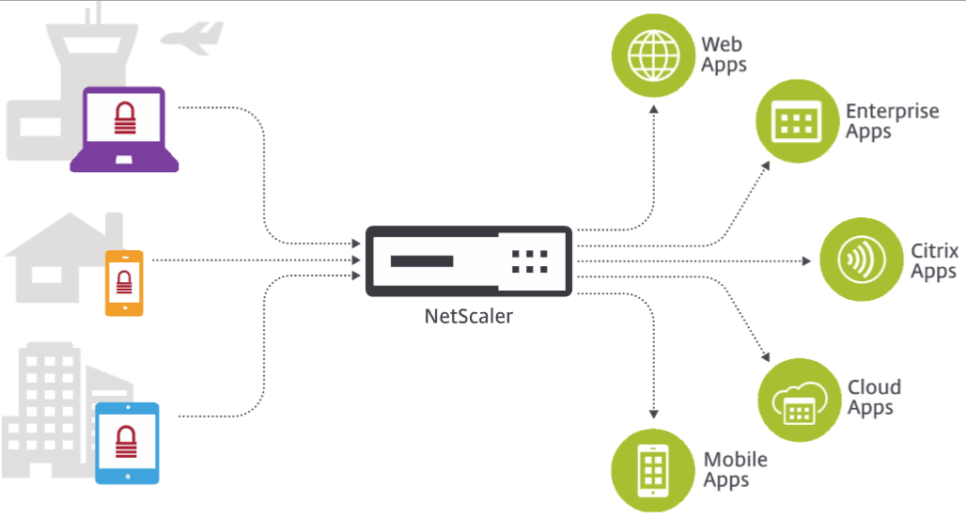
NetScaler SmartAccess/SmartControl
Change HDX session behavior
Enable/disable based on connection decision
NetScaler Gateway virtual server
Session Policy Name
Endpoint Analysis (EPA) scan results
Control published resource visibility
Application-based SSO
Contextual security information for dynamic access control

Slide 56
NetScaler SmartAccess/SmartControl Demo

Slide 57
Admin Rights?

Slide 58
Admin Rights?
REMOVE THEM EVERY WHERE YOU CAN!!!!!!!!!!!
Of the 240 vulnerabilities published by Microsoft in 2014 with a Critical rating, 97% were concluded to be mitigated by removing administrator rights.
There has been a 63% year on year rise in Critical vulnerabilities since 2013.
98% of Critical vulnerabilities affecting Windows operating systems could be mitigated by removing admin rights
99.5% of all vulnerabilities in Internet Explorer could be mitigated by removing admin rights
95% of vulnerabilities affecting Microsoft Office could be mitigated by removing admin rights
97% of Critical Remote Code Execution vulnerabilities could be mitigated by removing admin rights
80% of all Microsoft vulnerabilities reported by us in 2014 could be mitigated by removing admin rights.

Slide 59
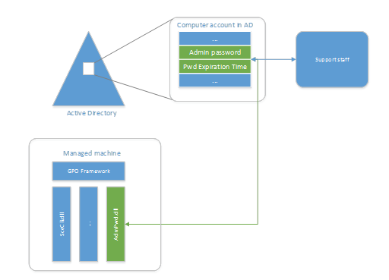
Local Administrator Password Solution (LAPS)
Management of local account passwords
Domain joined computers
Passwords stored in Active Directory
ACL protected
Random generated
Managed by
Group Policy
PowerShell
Agent
Notes:
https://www.microsoft.com/en-us/download/details.aspx?id=46899

Slide 60
Local Administrator Password Solution (LAPS) Demo

Slide 61
Service Accounts?

Slide 62
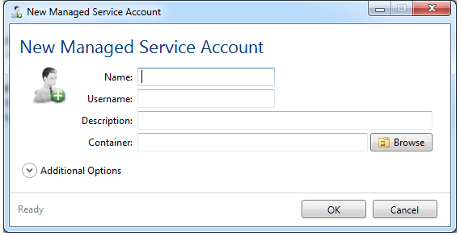
Managed Service Accounts (MSA)
Active Directory Controlled
Responsible for changing passwords
Automatic password management
Never expire service accounts
Control MSA hosts by account
Management
PowerShell
Managed Service Accounts GUI
Notes:
http://www.cjwdev.com/Software/MSAGUI/Info.html

Slide 63
Managed Service Accounts (MSA) Demo

Slide 64
AntiVirus
There are lots of little bugs out there.

Slide 65
Anti Virus
When we first started down the XenApp world and then the VDI world AV has been the big debate at many levels.
Typical AV Weaknesses
Too much overhead, ProjectVRC went over this in 2013, You can loose 10-30 of your density.
Doesn’t understand multi User OS’s with SBC\XenApp.
Causes frequent updates to the image which can add a whole lot of time to maintain the image. Requires frequent DAT updates that in some cases that can crash some systems just keeping it up to date.
They all have complicated policies that don’t know Citrix\VMware in general of some basic exclusions
Most are not Hypervisor aware which means tons of agents and not using basic guest introspection that is available from XenServer, ESX and Hyper-V now.

Slide 66
Major Players + Claim to Fame
Bit9- NextGen - Detonate-and-Deny
BitDefender - HVI=Hypervisor Integration (XenServer, ESX and HyperV)
Cylance - NextGen, AI
Carbon Black - NextGen
Kaspersky – Classic Huge Solution Options
McAfee – Classic Huge Solution Options
Palo and Cisco – Classic Huge Solution Options
Symantec – Classic Huge Solution Options
TrendMicro - Classic + Guest introspection

Slide 67
Beyond AppLocker

Slide 68
Beyond AppLocker
Ivanti – Application Manager, takes AppLocker to another level.
Avetco – Super Cool Stuff that can limit applications and give rights as needed.
There are a couple other tools out there that are now bundled with AV solutions.
AV + something Next Gen lots of options out there. AV can do a good amount but doing some of the best practices will go further and also help more and cost less. I’m not advocating not running AV but I’m just saying the money and time spent doing this will pay off a whole lot more.

Slide 69
Windows Server 2016 Enhancements

Slide 70
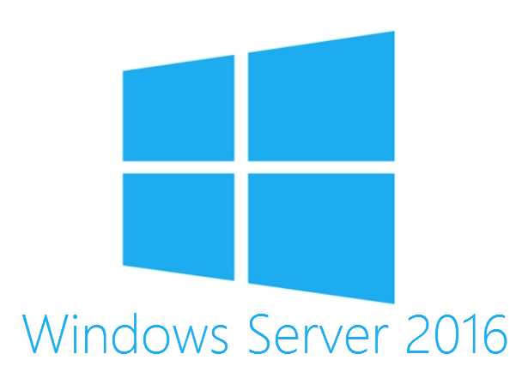
Windows Server 2016 Enhancements
Not Supported Yet…
Secure Boot
Virtual TPM
Shielded VMs
DeviceGuard - Protect Windows Sensitive Bits
CredentialGuard

Slide 71
Windows Server 2016 Demo

Slide 72

Notes:
Kurt Moody
The basic flow of the demo is as follows:
Secure HDX connection is established to a XenApp 7.14 Hosted Shared desktop session running in a WS2016 DataCenter Edition Guest VM on WS2016 Hyper-V.
Msinfo is launched to display that Credential Guard is not yet enabled on this XenApp Server.
Mimikatz is used to dump the LSA information in a command prompt
We highlight that MalUser01 is found and that we can see the three hashes that may be used by a bad actor to initiate a “Pass-the-Hash” style attack if a user session has been compromised.
We then launch gpedit in order to show and enable the GPO for Credential Guard, we reboot
Upon reconnecting through HDX we again run msinfo demonstrating that Credential Guard is now configured and running within the users session.
Mimikatz is used again but this time the NTLMhash has been further encrypted within the Isolated LSA, blocking a bad actor from using these credentials in a “Pass-the-Hash” style attack.
We then close out the demo

Slide 73
Callouts
Denis Gundarev @fdwl
How to Encrypt Everything That Moves and Keep It Usable BriForum 2015
Paul Cooke
Microsoft AppLocker Deep Dives
Lena Yarovaya
NetScaler Application Firewall Goodness YoY
Project VRC @ProjectVRC
Winders Optimization and Testing champions.
More to Come

Slide 74
References
Secure Windows DNS Checklist
https://technet.microsoft.com/en-us/library/cc770432.aspx
DNSSec
https://technet.microsoft.com/en-us/library/ee649205(v=ws.10).aspx
Server OS Hardening Guide
https://technet.microsoft.com/en-us/security/jj720323.aspx
More To Come

Slide 75
Time to Implement
Citrix Policies (3 Unfiltered, Lockdown, Unlock Internal, Unlock External) (3 Hours)
Citrix SSL Party (XML, SF, LS, Director) (8 Hours + 8 Testing)
Image Optimization (1 Script or EXE) (5 Minutes + 8 Hours Testing)
Windows AppLocker (20 Known Good Applications) (16 Hours + 16 Testing)
Windows Firewall (20 Rules) (16 Hours + 16 Testing)
Networking VLANs +DNS Hardening and DNSSEC (24 Hours + 24 Testing)
NetScaler Application Firewall (1 Application 16 Hours + 16 Testing)
Windows Firewall + IPSec (Root CA Setup + Group Policy Settings to enable it) (16 Hours + 16 Testing)
Third Party Thingys – Mileage will vary.

Slide 76
Conclusion Part 1
There are some pretty free and easy things to implement to make things more secure.
Then there are things that take longer to do but they are free.
Then there are products to help make it more secure but cost some money.
Most people that use Citrix deploy their most important applications and if there is an outage or a breach it is a huge deal which can be a resume generating event.
AV, we need to run it to have a chance to stop, slow or alert attacks.
I will be making a document in Q3 of 2017 which will be released which will show step by step on how to do all the things mentioned in this presentation.

Slide 77
Conclusion Part 2
You don’t need to be the Lone Ranger and try and do this all on your own.
Be the driving force to make some or all of these changes since many of them will just cost you some time or maybe another departments time.
Security will not be easier in 2017 if we don’t change our bad habits in some cases for the past 20+ years.
I hope some of you take at least 2-3 of these things back to your shop and pilot and test them and roll them out.
If you have a security team, AD, DNS, Network team then many of these things should be able to be given to them nicely (No need for putting anyone in front of or near the front of the bus just talk to them before they keep walking much further)

Slide 78
Citrix VDI Hardening Punch List
Default Policy Smackdown
Image Optimization
Pick a Good AV (Tune It)
Prevent Bad Applications from running (AV, AppLocker or 3rd Party, DeviceGuard)
SSL Party
Windows Firewall\MicroSegmentation
Network Party (DNSSec, WAF)

Slide 79
Synergy 2017 Announcements
Lots of Mentions of Security which was cool but it was lacking on details, packaging and pricing.
NetScaler is a serious WAF solution but doesn’t get any love.
Citrix Analytics (Looks super cool) Looks to be better starting point than some SIEMs along with LogRythm and Splunk)
Supervised Mode - Known behavior
Unsupervised Mode - Learns to catch deviations Net new Behaviors
Citrix Analytics Questions
How is it priced (Per GB Per Day, Number of Connections)
How much does it cost?
Lets see the details (I’m not a cool kid like many of you to know more yet and my questions didn’t get too far)
Showing the Kill Chain and Risk Escalation was awesome.

Slide 80
Security Nugget - KRBTGT Kerberos Isn’t that secure
It has been around for since the first domain and it is still here in 2012 R2.
Run “net user krbtgt /domain” it may be as old as your domain is. If you have changed every password for all the accounts except this one this attack will still own your domain.
Mitigation, reset the accounts Password Twice on the PDC
http://rycon.hu/papers/goldenticket.html To See how to use this attack and also check how old your current KRBTGT hash is.

Slide 81
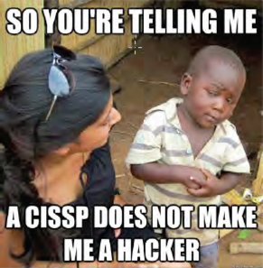
Security Nugget - ADMIN ACCOUNTS = Hacker paradise
Don’t use a admin account to check your mail or browse the internet.
Domain Admins, reduce to 2-4
Enterprise Admins, reduce to 2-4
Use Delegated Control and Server Admin Groups
Citrix Admins
SQL Admins
VMware Admins
HelpDesk
Keep a short list of nerds with access to everything and use Jump servers to administer core components of your deployment.
AppLocker, Firewall, IPSec, AV, Logging Policies

Slide 82
Our Next Goals
Default Policy Showdown with Citrix and VMware (Which one is more secure)
Then what you need to turn off from the default policies
Windows Firewall
How to turn it on your Infrastructure Servers (With PSRemoting, SMB and RDP Exclusions)
Lockdown Guides Per Solution (Citrix, VMware and Microsoft)
Work with some of you all on showing off how to schedule security updates in MCS, PVS, IC deployments.
Whatever other nerdy things we come across

